Slide 1
Nailed It!
2018 NEAFCS Annual Conference
Awards and Recognition Training Subcommittee Presentation

Slide 2
Award Applications

Slide 3
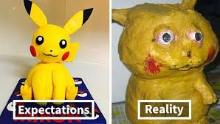
I want to apply for an award… and I want to WIN. What do I do? Secret weapon →www.neafcs.org←

Slide 4
Requirements
Read all!
Awards Manual is 98 pages. Read 1-7 and then read your specific award requirements.
Don’t assume anything
Phone a friend
Been there done that
Ask for help from winners

Slide 5
Requirements
Dues must be postmarked by December 31st
Lead author must be an active or life member
Only one 1st place individual award and one 1st place team award, as lead author, in the same year. You will be asked to choose. (not counting DSA or CE)
A member (team or individual) cannot receive the same award 2 consecutive years

Slide 6
Tips
We are all doing impactful programming based on our needs assessments.
When planning your programs, first - figure out how, and if, you can measure the impact. If not, change something so you can. Use measuring/evaluation tools!
Use the NEAFCS judges sheets to create your program
Add at least one element that will make your program stand out from others.

Slide 7
MoreTips
Network to see if someone in another county, district or state, might be interested in creating the program with you and/or implementing it in their area. DOUBLE impact!
Ask to present your program in other counties or districts.
PROOF READ! Do not abbreviate. Use other eyes!
Submit applications in several categories

Slide 8
Look out
2 Due Dates
State - ? Find out
National – March 15th
2019 Awards Manual
November 15th 2018

Slide 9
Changes
2019 New Award
Innovative Youth Development Program
Educational Technology Award and Internet Education Technology Award will be combined.

Slide 10
Guidelines
www.neafcs.org

Slide 11
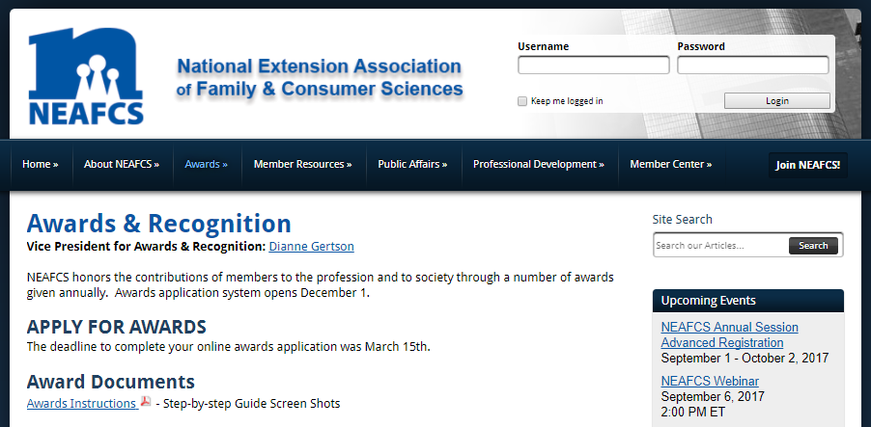
Guidelines
Notes:
Award criteria and the application process are on the NEAFCS Web Site at neafcs.org.
Select and click on the Awards category on the home page, and you will get the main page for Awards and Recognition. Go to the Awards Manual.
Review the General Eligibility Requirements on pages 3 – 5 of the Awards Manual. These requirements apply to all awards categories.
Next, select the award you are interested in applying for to obtain more information about what is needed to successfully submit your application.
Make sure you carefully follow the specific guidelines and criteria, i.e., years of service, etc. These are different for each award and individuals who do not follow the guidelines will be disqualified.
How do I know which Awards category works best for my program?
Not all programs fit in all categories. Try to find the right award for your program.
If you have questions, please contact your affiliate Vice President for Awards and Recognition.
Do all awards need a letter of recommendation?
No. Requirements for some awards have changed so check the Awards Manual carefully to see if your award application requires a letter of recommendation.
If your letter of recommendation is going directly to the Awards chair in your state, it might be a good idea for you to check and see if it has been received, so that your award is not disqualified.

Slide 12
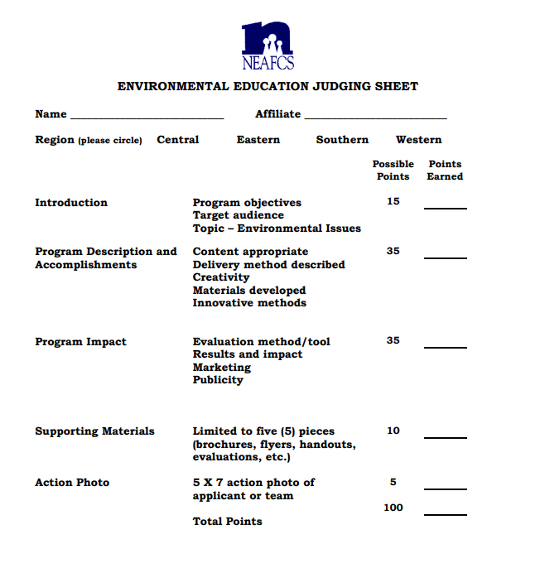

Slide 13
Questions?
Affiliate Vice President of Awards
NEAFCS Vice President of Awards
Susan Routhe - Oklahoma

Slide 14
Nailed It!
2018 NEAFCS Annual Conference
Awards and Recognition Training Subcommittee Presentation

